Slide 1
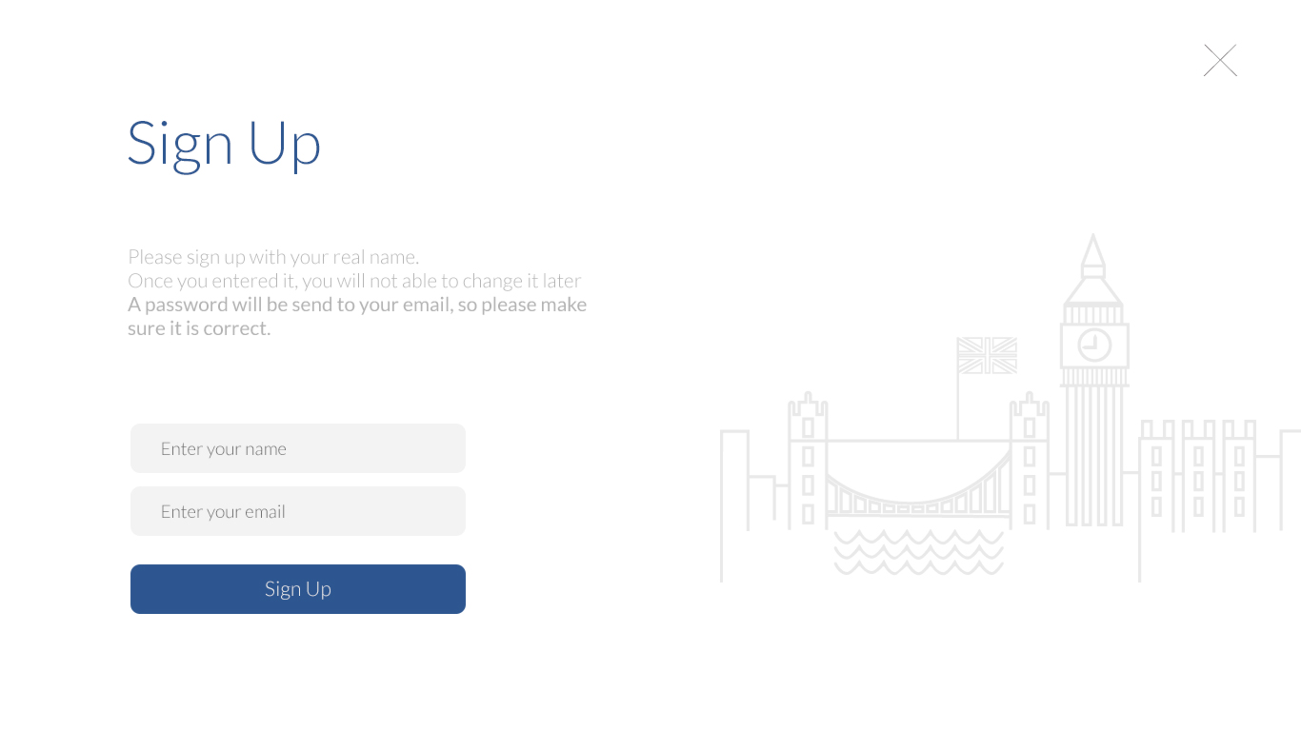
Div-wrapper : background
padding
Button -Btn_close : absolute
Div-Signup-wrapper
Header h1
Header h1
margin-top
Div contents , p, strong
margin-bottom
Div-field
Input text-name
Div-field
Input text-email
margin-top
Div- btn-area
Btn-

